Slide 1

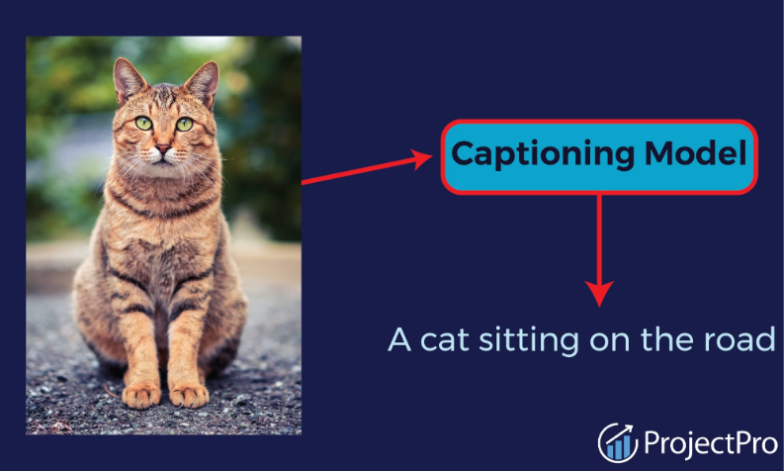

Image Captioning System
This presentation provides an overview of an advanced image captioning system, which uses deep learning to automatically generate descriptive captions for images. The system bridges the gap between visual data and natural language, enabling accessible and intelligent image understanding.
by Shivam Vishwakarma

Slide 2

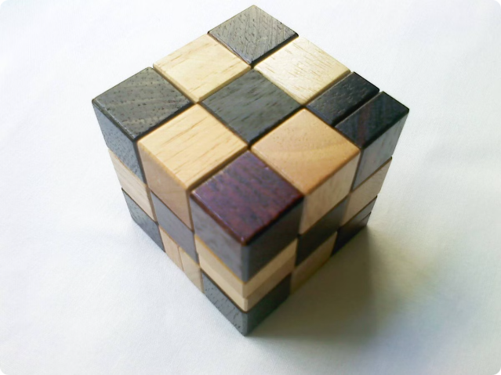
Problem Statement
1
Challenge
Describing the intricate process of understanding visual content and generating coherent, meaningful captions that accurately capture the essence of an image.
2
Goal
Developing a model that can effectively and reliably translate visual data into natural language, enabling widespread applications in accessibility, search, and more.

Slide 3
Fliker 8k Dataset
Purpose: Flickr8k is used for training and evaluating image captioning models, bridging computer vision and natural language processing.
Content: It contains 8,000 images from Flickr, each annotated with five different captions describing the visual content.
Diversity: The images cover a wide range of scenes and activities, while the captions offer various descriptions, enhancing model flexibility.
Applications: Used for image captioning, transfer learning, and developing accessibility tools for the visually impaired.
Evaluation: Flickr8k serves as a standard benchmark for comparing image captioning models, often evaluated using BLEU scores.

Slide 4
Architecture Overview
VGG16 Encoder
LSTM Decoder
Training Process
The VGG16 convolutional neural network is used as a feature extractor, with the penultimate layer output serving as a compact representation of the input image.
An LSTM-based sequence generator takes the image features and previously generated tokens as input to predict the next word in the caption, effectively translating visual data into natural language.
The model is trained on a dataset of images and their corresponding captions, using categorical cross-entropy loss and the Adam optimizer to optimize the caption generation.

Slide 5
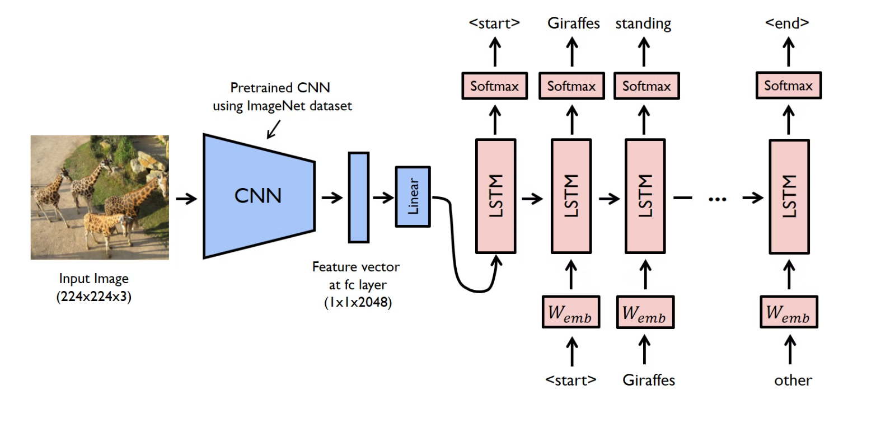
Visual Representaion of the Model

Slide 6
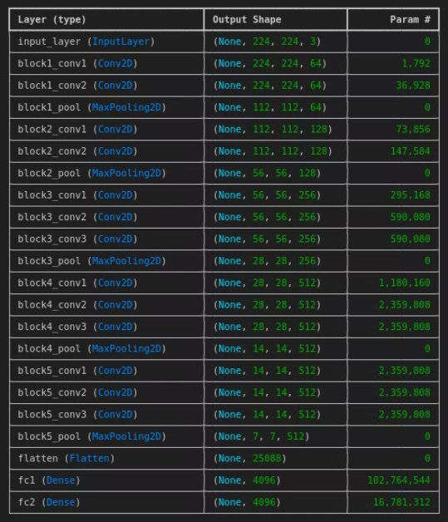
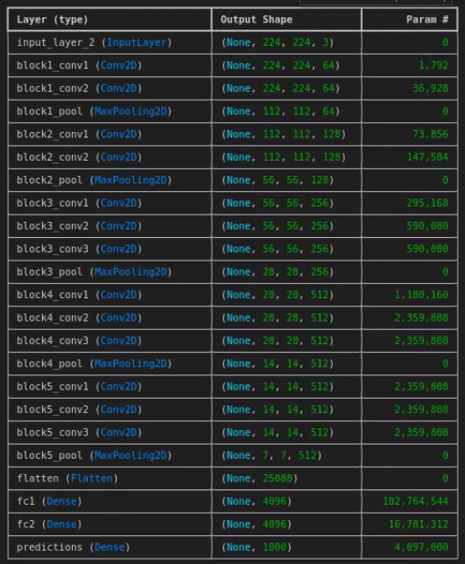
Pruned VGG-16 Model
VGG-16 Model for Feature Extraction
Complete VGG-16 Model

Slide 7
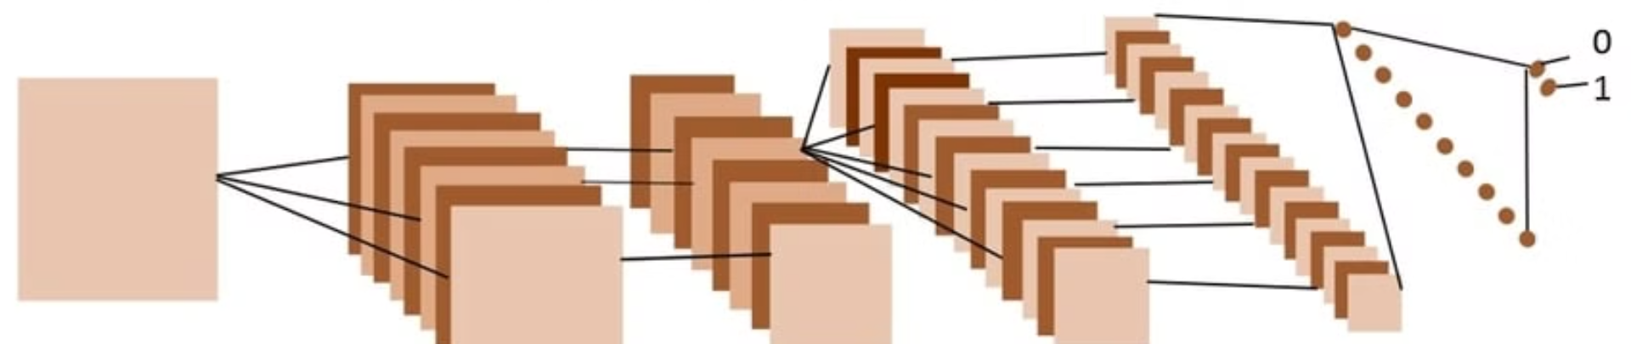
Feature Extraction of Images
Loading Images: Resize images to 224x224 pixels (standard input size for VGG16).
Preprocessing: Convert images to NumPy arrays, reshape, and scale pixel values using preprocess_input() to match VGG16's input requirements.
Feature Extraction: Pass preprocessed images through VGG16 to extract features from the penultimate layer (bottleneck features).
Storing Features: Save extracted features in a dictionary with the image ID as the key and the feature
vector as the value.

Slide 8
Data Preprocessing of the Caption
Loading Captions:
Read captions from a text file.
Separate image IDs from their captions.
Creating a Mapping:
Map each image ID to its corresponding captions.
Standardize image IDs by removing file extensions.
Text Cleaning:
Convert captions to lowercase, remove digits, punctuation, special characters, eliminate extra spaces.
Add startseq and endseq tokens to each caption.
Storing all the Captions:
Stored all the caption in a list in all_captions

Slide 9
Tokenization
Tokenization Overview:
Convert textual captions into sequences of numerical tokens.
Creating the Tokenizer:
Use Tokenizer() from Keras to process all captions.
Fit the tokenizer on the entire corpus of captions (all_captions).
Vocabulary Size:
Calculate the vocabulary size based on the tokenizer’s word index.
Include an additional index for padding or unknown tokens: vocab_size = len(tokenizer.word_index) + 1.
Maximum Caption Length:
Determine the maximum length of any caption in the dataset.
This helps in standardizing input sequences through padding.

Slide 10
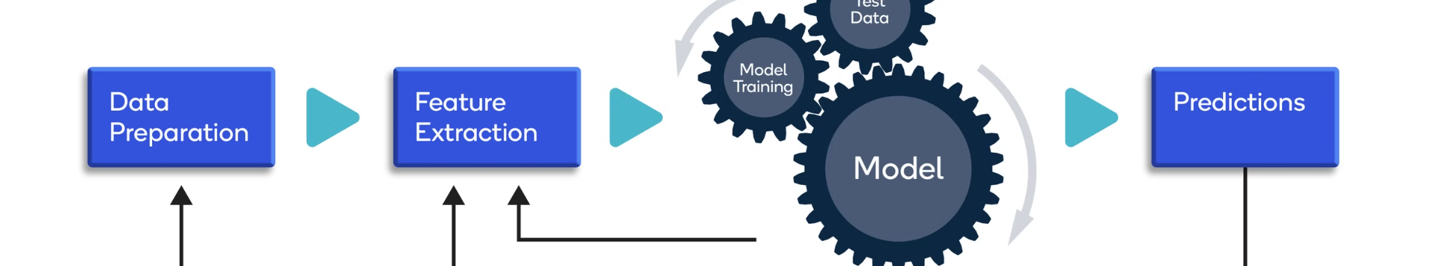
Data Preparation
Data Splitting:
The dataset is split into two parts: 90% for training and 10% for testing.
Batch Processing:
A data generator is used to process the data in small batches, which helps prevent system crashes during training.
Data Preparation:
For each image, the corresponding captions are broken into input-output pairs.
The input is part of the caption, and the output is the next word in the sequence.
These pairs are padded to ensure they are the same length.

Slide 11
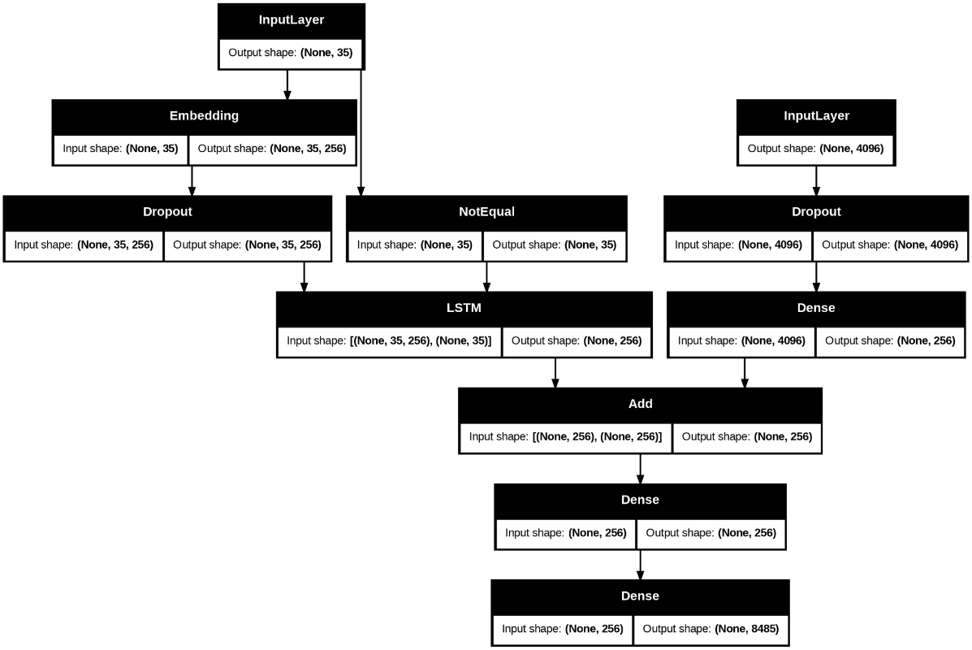
Model Architecture in Detail

Slide 12
Model Traning
Model Components:
Image Features: Extracted using the VGG16 model, followed by dropout and dense layers to reduce overfitting and dimensionality.
Text Features: Captions are tokenized and passed through an embedding layer, dropout, and an LSTM layer for sequential understanding.
Decoder: Combines image and text features, and passes them through dense layers to predict the next word in the caption.
Training Process:
The model is trained over multiple epochs using a batch size of 32.
For each epoch, the model learns from the data and adjusts its parameters to improve caption prediction.
Optimization:
The model is compiled using the categorical cross-entropy loss function and the Adam optimizer, which helps in minimizing errors during training.
Saving the Model:
One the model is trained, save the model : model.save(my_model.keras).

Slide 13
Model Evaluation
Evaluation Data:
The model is evaluated on the test data, which is 10% of the dataset that was not used during training.
Prediction:
For each image in the test set, the model generates a caption.
The predicted caption is then compared to the actual captions associated with the image.
BLEU Score:
BLEU-1 Score: Measures the accuracy of single-word matches between the predicted and actual captions. The BLEU-1 score achieved is 0.545007, indicating that over 54% of the words in the generated captions match the actual captions.
BLEU-2 Score: Considers pairs of words (bigrams) to assess the fluency and context of the generated captions. The BLEU-2 score is 0.317127, reflecting that 31% of word pairs in the predicted captions are accurate.
Performance Insight:
The BLEU scores indicate that the model generates captions with a reasonable level of accuracy, capturing key words and some context, but there is still room for improvement in generating more fluent and contextually rich captions.

Slide 14
Streamlit App
Purpose:
The Streamlit app allows users to upload an image and generate an automatic caption using the trained image captioning model.
Features:
User Interaction:
The app provides a user-friendly interface where users can easily upload images for captioning.
Real-time Caption Generation:
Once an image is uploaded, the app processes the image, extracts features using the VGG16 model, and generates a caption using the trained captioning model.
Display:
The app displays the uploaded image alongside the generated caption, making it easy for users to see the results instantly.
Workflow:
Image Upload:
Users can upload an image in JPG format.
Image Processing:
The uploaded image is resized and preprocessed to match the input requirements of the VGG16 model.
Feature Extraction:
The VGG16 model extracts features from the image, which are then passed to the captioning model.
Caption Prediction:
The captioning model predicts a sequence of words based on the image features, generating a caption that describes the image.
Result Display:
The app shows the uploaded image along with the generated caption.

Slide 15

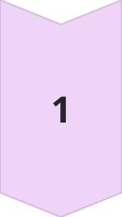

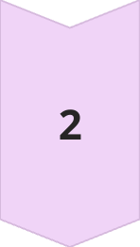
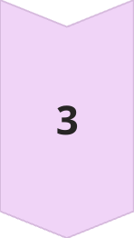
Applications
Accessibility
Image captioning can provide visually impaired individuals with detailed descriptions of visual content, improving accessibility and inclusion.
Search and Retrieval
Automatically generated captions can enhance image search and indexing, enabling more accurate and intelligent information retrieval.
Visual Assistants
The image captioning system can be integrated into virtual assistants to provide users with visual context and enhance their overall experience.

Slide 16

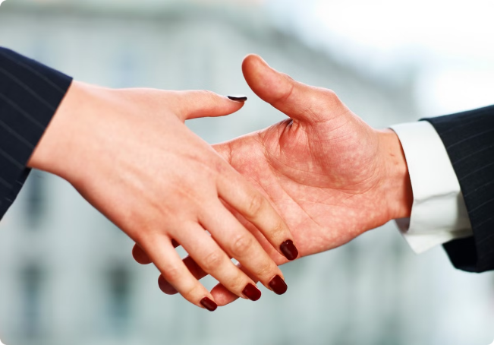
Conclusion
1
Summary
This presentation has showcased the development and implementation of an advanced image captioning system, which bridges the gap between visual data and natural language.
2
Future Directions
Ongoing research and advancements in deep learning, along with the availability of larger and more diverse datasets, hold the promise of even more accurate and versatile image captioning systems in the future.
3
Impact
The widespread adoption of image captioning technology can have a transformative impact on accessibility, search, and various other applications, ultimately enhancing the user experience and understanding of visual content.

